Slide 1
Properties of glass, ceramics and metals
Lesson Objectives:
to describe the properties and uses of glass/ceramics
to describe the properties and uses of metals
Starter: List as many uses for glass as you can...

Slide 2
Lesson outcomes
Pass:
Identify some properties and uses of glass/ceramics
Identify some properties and uses of metals
Make some links between the properties and their uses
Merit:
All of Pass outcomes plus...
Detailed links between the properties and uses
Distinction:
All of Pass outcomes plus...
Very thorough and detailed links between the properties and uses

Slide 3
What is glass?
Glass is a combination of sand (silica) and other minerals that are melted together at a very high temperature
Obsidian is a hard, black, glassy type of stone occurs naturally around the mouth of a volcano when an eruption melts the sand
Silica is melted and combined with soda ash and limestone to make glass
Different substances can be added to glass to change its properties

Slide 4
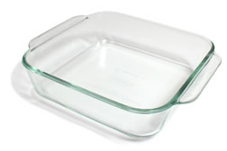
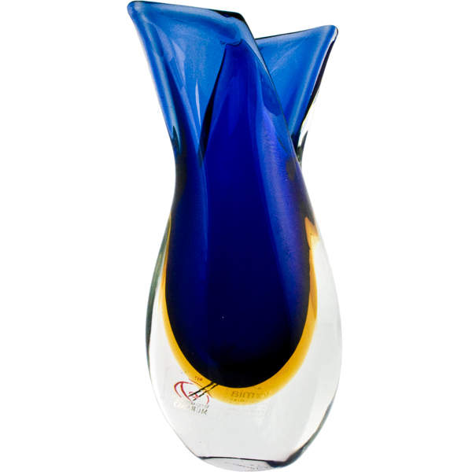
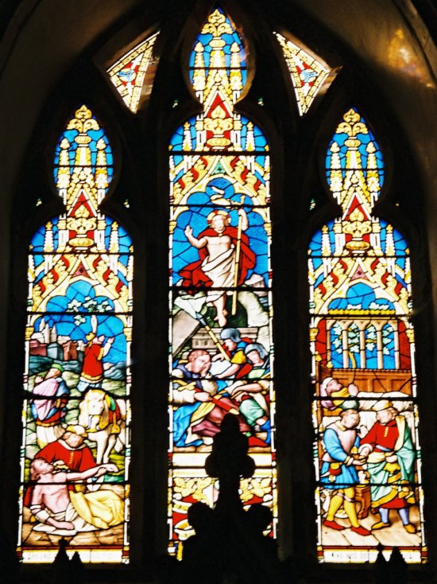
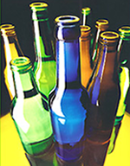
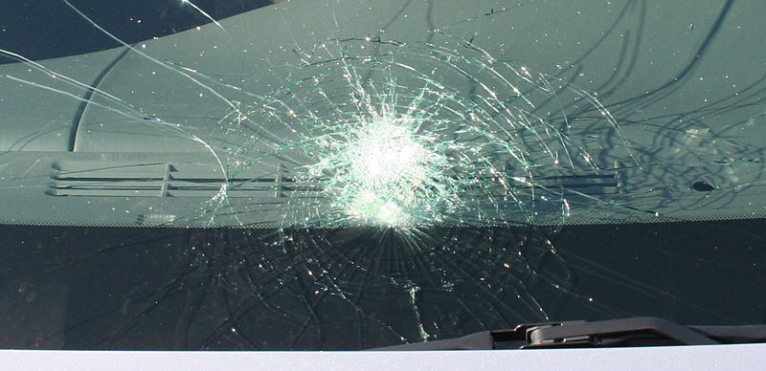
glass
http://www.britglass.org.uk/types-glass

Slide 5
What are ceramics?
Ceramics are non-metallic, solid materials that have been formed by heating and then cooling
There are different types of ceramic materials:
Structural ceramics, such as brick and roofing tiles
Whiteware ceramics, such as pottery, porcelain and tableware
Technical ceramics, such as those used in the Space Shuttle project and biomedical implants

Slide 6
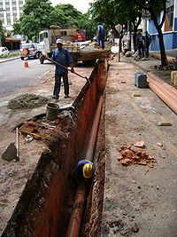
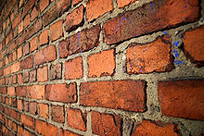
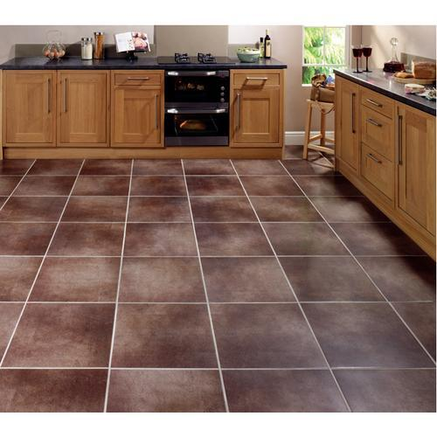
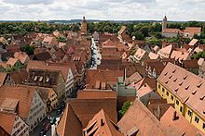
Structural ceramics

Slide 7
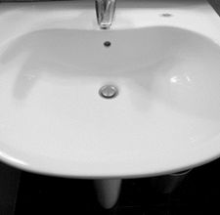
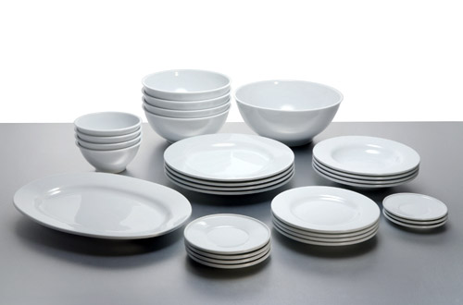
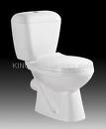
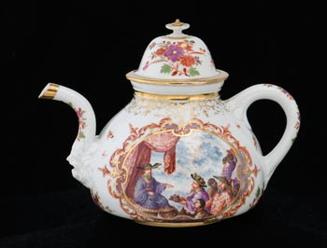
Whiteware ceramics

Slide 8
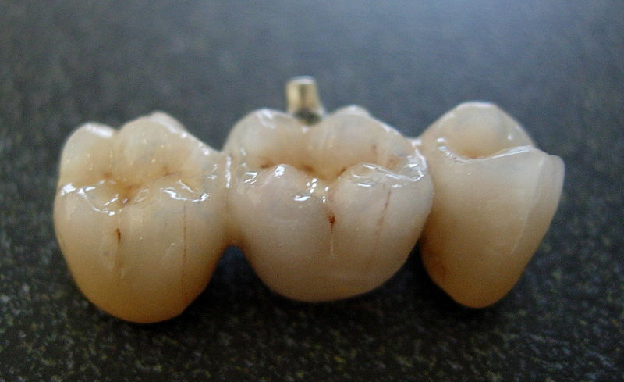
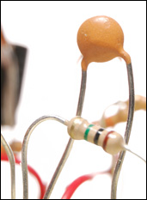
Technical ceramics

Slide 9
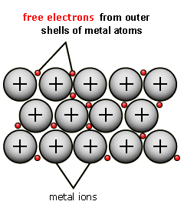
metals
All metals are made from metal atoms. For example, copper is made from copper atoms and magnesium is made from magnesium atoms
The metal atoms all form ‘metallic bonds’ and this is where the metals get their properties

Slide 10
Properties and uses of metals
http://www.teachnet-uk.org.uk/2006%20Projects/Sci-Reactivity_of_Metals/reactivity_of_metals/Uses%20of%20Metals%20Matching%20Exercise.htm

