Slide 1
Natural vs synthetic fibres
Lesson Objectives:
to describe the properties and uses of some natural fibres
to describe the properties and uses of some synthetic fibres
Skills:
Making notes
Recording results

Slide 2
Lesson outcomes
Pass:
Identify some natural and synthetic fibres
Compare the tensile strength natural and synthetic fibres
Describe some other properties and uses of natural and synthetic fibres
Merit:
All of Pass outcomes plus...
Detailed links between the properties and uses of natural and synthetic fibres
Distinction:
All of Pass outcomes plus...
Very thorough and detailed links between the properties and uses of natural and synthetic fibres

Slide 3
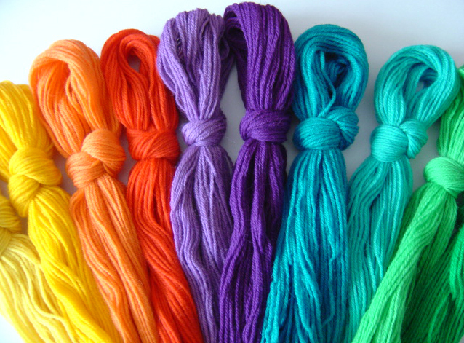
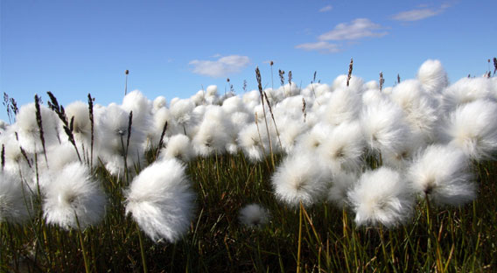
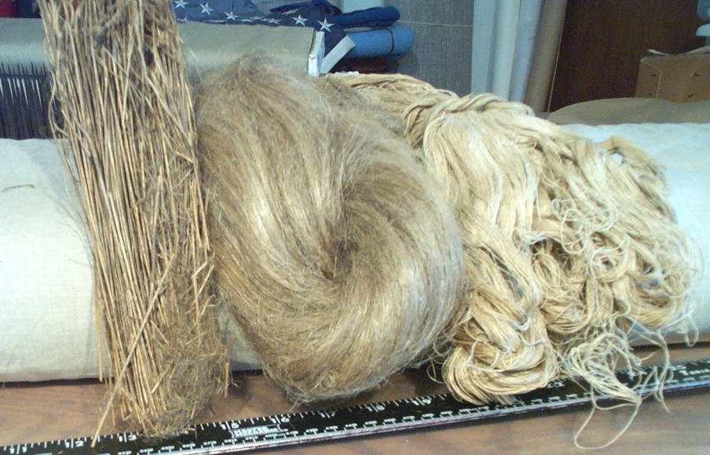
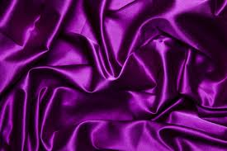
Natural fibres
Natural fibres come from plants and animals.

Slide 4
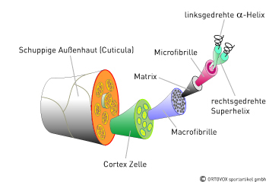
Wool
Wool is a complex protein fibre.
Over 20 amino acids make up the protein polymer
Wool also contains small amounts of fat, calcium and sodium
This chemical structure of wool strongly influences its properties.

Slide 5
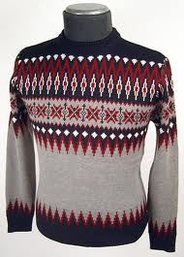
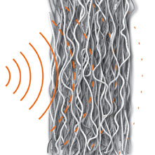
Heat and noise insulation
Wool insulates against heat and cold. It is comfortable in both hot and cold weather because it absorbs moisture vapour.
The crimp in the wool fibres makes them
stand apart from each other trapping
insulating air between the fibres.
In hot weather the absorption/evaporation process works to help keep the body cooler.
Wool absorbs noise and reduces noise levels.

Slide 6
Fire resistant
Wool does not have to be specially treated to become non-flammable. A fabric made entirely of wool is difficult to ignite, burns slowly, and has limited ability to sustain a flame. Wool does not melt when burned and so cannot stick to the skin and cause serious burns.

Slide 7
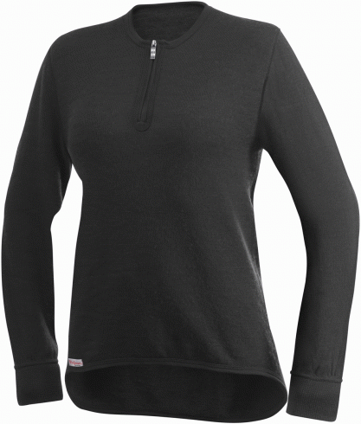
Water repellent
Although wool can absorb moisture, it repels liquids. It is naturally hydrophobic. The scales on the outside of the fibre cause liquid to roll off the surface of the fabric. Even if wool does eventually get wet it generates heat and keeps the body warm, not cold and clammy.

Slide 8
Dirt resistance
Wool's ability to absorb moisture and therefore its low build-up of static electricity means that wool does not attract lint and dust from the air.
The crimp in the fibre and the scales on the outside of the fibre prevent deep dirt from penetrating the fabric.

Slide 9
Elasticicity and durability
Wool has greater elasticity than any other plant or animal fibre. Wool can be twisted, turned and stretched and will still return to its natural shape.
The interlocking protein molecules in the fibres of wool have the power to elongate, stretch and recover, creating an extremely robust fabric that will last. Each wool fibre is made up of millions of 'coiled springs' that stretch and give rather than break.

Slide 10
Versatility, comfort and ability to dye
Different sheep breeds with their own unique fibre characteristics provide different wools for a wide range of products.
Wool is comfortable to wear because of its elasticity, and moisture absorbing qualities.
Wool is easy to dye. The scales on the surface of the wool fibre diffuse light giving less reflection and a softer colour. The proteins in the core of the fibre absorb and combine with a wide variety of dyes and allows the wool to hold its colour.

Slide 11
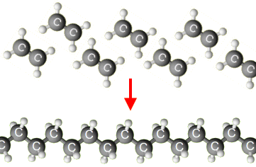
Synthetic fibres
Polymerisation
Some small molecules can join together to make very long molecules called polymers. This process is called polymerisation.
Many polymers are made from chemicals that are obtained from crude oil. For example, molecules of ethene join together to make poly(ethene), commonly known as polythene.
http://www.bbc.co.uk/learningzone/clips/making-polythene-cracking-and-polymerisation/4427.html

Slide 12
Condenstion polymerisation
Some polymers are not made from alkene monomers. These are called condensation polymers. Nylon and polyesters are like this.
They can be drawn into very fine fibres and woven into cloth for clothing.
Often, natural fibres such as cotton are mixed with nylon or polyester fibres to make a soft but hard-wearing cloth.

Slide 13
nylon
There are different types of nylon, each with it’s own set of properties.
The crystalline nature of nylon gives it the following properties –
Excellent wear resistance
Excellent chemical resistance
Very good heat resistance
Nylon is also –
Strong and elastic
Easy to launder
Quick to dry
http://www.bbc.co.uk/learningzone/clips/the-use-of-nylon-in-parachutes/2164.html

