Slide 1
The Electromagnetic Radiation
(Light – the Supreme Informant!)

Slide 2
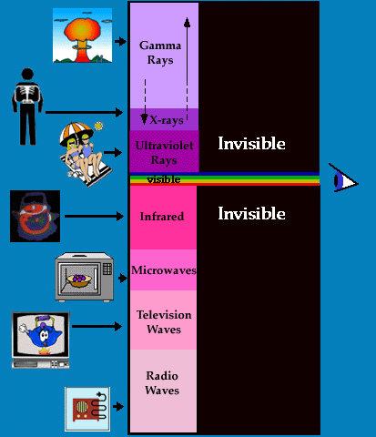
The Electromagnetic Spectrum
More than meets the eye!

Slide 3
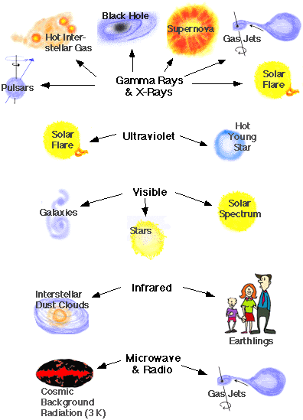
Examples from Space!

Slide 4
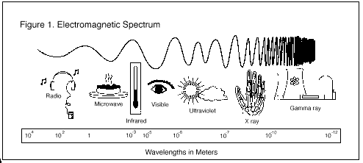
Wavelength
The distance from one wave crest to the next
Radio waves have longest wavelength and Gamma rays have shortest!

Slide 5
Wavelength Units
Meters (like on last slide and in book, p. 613)
More commonly in nanometers (1 nm = 10⁻⁹ meters)
Angstroms still used
Named for Swedish Astronomer who first named these wavelengths
1 nanometer = 10 Aº

Slide 6
How light or electromagnetic radiation is used in Astronomy
Astronomers use a tool called a spectroscope to separate starlight into its colors – in this way, they can tell what a star is made of, its temperature, luminosity and so on…
Astronomers can look at astronomical objects at different wavelengths…

Slide 7
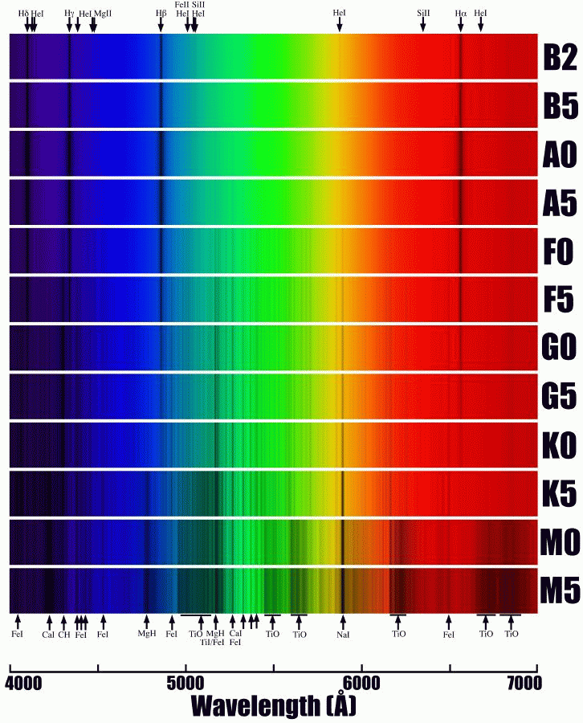
Spectra of a Star

