Slide 1
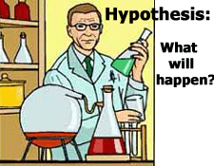
Hypothesis

Slide 2
Hypothesis
Have you ever made a guess about how something works?
Have you ever tried to predict what the score in a football match will be? Or who you think will win X-Factor?
If you have answered yes, then you have made a hypothesis.

Slide 3
Hypothesis
A hypothesis is a guess or a prediction about what you think might happen or what you believe to be true.
It is something which you can then be proved or disproved by observation or collecting data.

Slide 4
Hypothesis
Hypothesis:
I believe that at least 60% of students in this classroom use MSN to chat to their friends.
Question to ask:
Do you use MSN to chat?

Slide 5
Use of this resource
This resource is covered by copyright legislation.
You may:
Guide students or teachers to access or display this resource from the teach-ict.com site
You may not:
Save this resource to a school network
Publish this resource on a school network, shared area, VLE or any website
Adapt or build on this work without prior permission from teach-ict.com

