Slide 1
GCSE in Electronic Products
Is it the option for you?

Slide 2
What is Electronic Engineering?
Electronics is an exciting, creative and interesting subject to study which involves:
  Designing Electronic Products through drawing, modelling and testing.
  Planning how to make the product using the circuit boards and components available.
  Selecting the materials and components to be used
  Making products using a wide range of equipment ranging from software design, to prototype tools, to automated circuit production equipment.

Slide 3
Electronics as a Career
Our world is full of electrical and electronic products. These range from the alarm clocks that wake us up in the morning, to the fridges that store our food, the radios and MP3 players we listen to, the computers and mobile phones we use, the control systems in the cars and buses we travel in .... From the moment we wake in a morning to the time we go to bed, our whole day will be influenced and affected by those products. They help to shape our lifestyle and also define us as the people we are.

Slide 4
Electronics as a Career
These products are usually made in large quantities and have to fill a lot of different, sometimes conflicting, design needs. They must be manufactured to an appropriate quantity and presented for sale at a reasonable price. To achieve this designers have to make many decisions with regard to how these products will function, their styling the materials used and how they will be made. They also have to take account of moral, ethical and sustainable issues.

Slide 5
How will you be Assessed?
This is a single award made up of two units.
Unit 1 - External Exam
Written paper: 2 hours (40%)
This exam has two parts:
Section 1 - A product study where you research a given product and answer a range of questions based on your research
Section 2 – A range of questions about Processes and Manufacture, Components, Technologies and Materials used in Electronics.
Unit 2 – Controlled Assessment
Course work: Design & Make (60%)
This coursework involves the design and manufacture of an Electronic Product. You will produce a design portfolio that will communicate the design and make processes you will follow. This portfolio and the product you make will provide the evidence for Unit 2. (Approx 20 pages of A3)

Slide 6




Where could I work?
Here are just a few possibilities ...

Slide 7
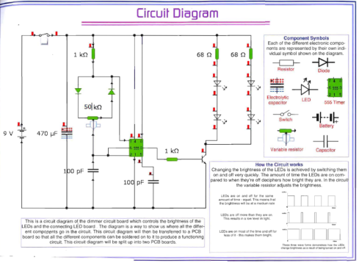
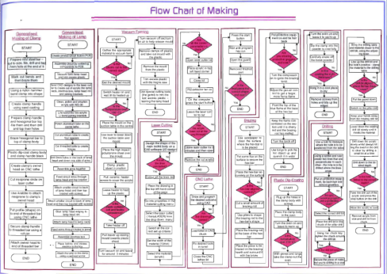
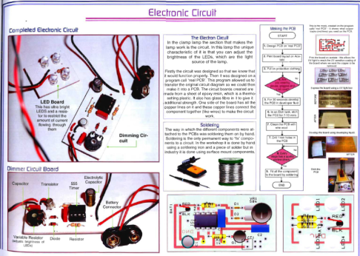
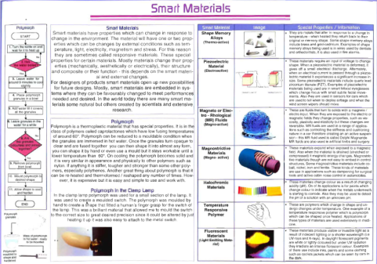
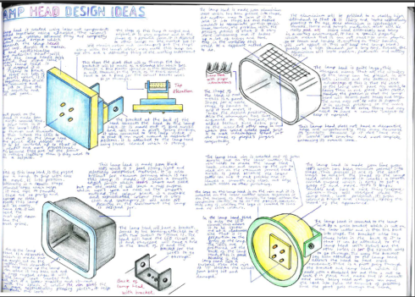
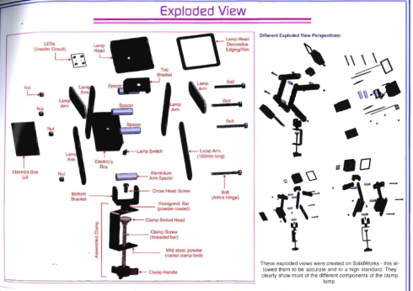
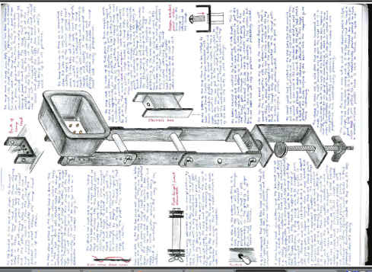
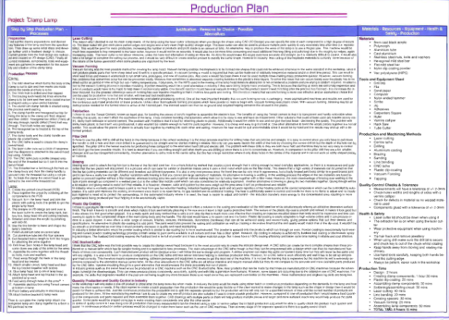
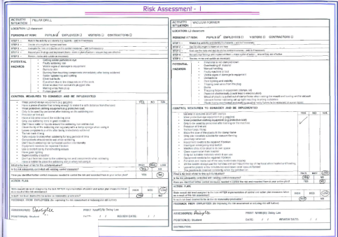
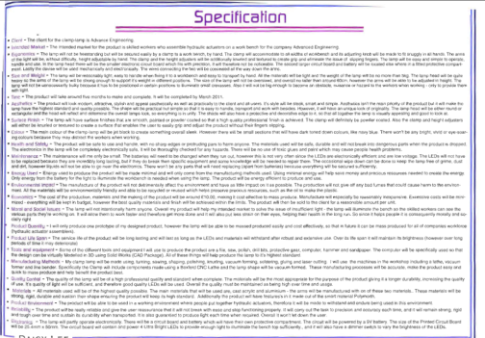
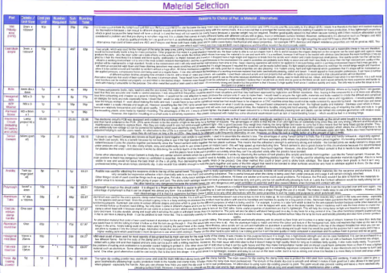
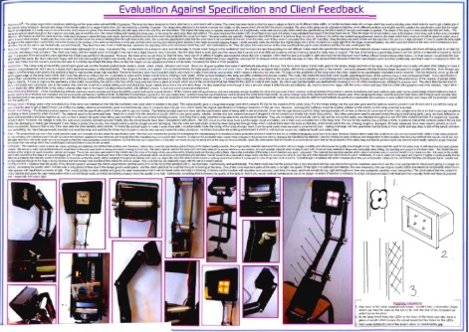
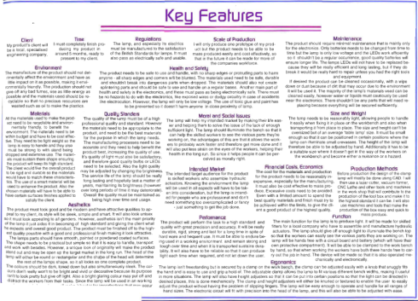
Exemplar Portfolio Pages
These pages are examples of the type and standard of work you will be expected to produce in your portfolio of evidence.

Slide 8
You Should Pick Electronic Products if...
You are interested in Electronics and how things are made and work
You want to be part of the future and make a difference
You want to be able to design and make a working product
You are able to produce practical work to a very high standard.

Slide 9
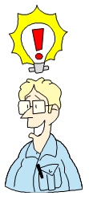
If you are interested in Electronic Products and want more information then speak to either Mrs Barker or Mr Barker in the Technology Department.

