Slide 1
GCSE in Engineering
Is it the option for you?

Slide 2
What is Engineering?
Engineering is an exciting, creative and interesting subject to study which involves:
  Designing products through drawing, modelling and testing
  Selecting the materials to be used
  Planning making activities
  Making products using a wide range of equipment ranging from hand tools, to machine tools, to automated equipment

Slide 3
Engineering as a Career
Most people associate Engineering with fabrication activities such as manufacturing cars or aircraft. Engineering activities are carried out in a variety of industries and there are a wide range of jobs available.
These include:
‘hands on’ practical roles (machine operators & fitters)
technical roles (designers and metallurgists)
management roles to the directors who run the company.
Almost every company that makes a product employs or uses Engineers.
GCSE Engineering will provide you with a broad introduction to Engineering. It will help you develop practical skills and understanding that will support a wide range of career options

Slide 4
How will you be Assessed?
This is a single award made up of two units.
Unit 1 - External Exam
Written paper: 1 hour (40%)
This exam has two parts:
Section 1 - A product study where you research a specific product and answer a range of questions based on your research
Section 2 – A range of questions about Manufacturing and Materials
Unit 2 – Internal Assessment
Course work: Design & Make (60%)
This coursework involves the design and manufacture of an Engineered Product. You will produce a design portfolio that will communicate the design and make processes you will follow. This portfolio and the product you make will provide the evidence for Unit 2. (Approx 20 pages of A3)

Slide 5





Where could I work?
Here are just a few possibilities ...

Slide 6

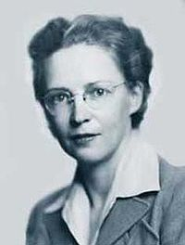
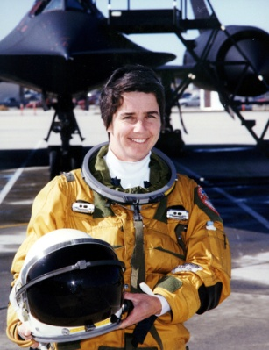
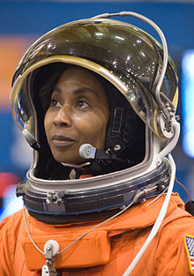
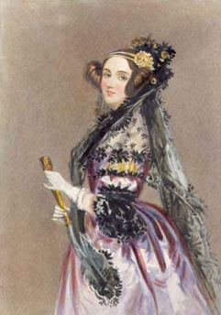
Is Engineering just for boys?
Kate Bellingham: British Engineer and Television Presenter.
Elizabeth MacGill, Canadian Engineer known as the "Queen of the Hurricanes". She was the world's first female aircraft designer.
Marta Bohn-Meyer: American pilot and Engineer
Stephanie Wilson: American Engineer and NASA Astronaught
Beatrice Shilling: British Aeronautical Engineer and Motorcyclist responsible for correcting a serious defect in the Rolls Royce Merlin Engine used during the Second World War
Augusta Ada King, Countess of Lovelace: Daughter of Lord Byron, Ada was an English writer known for her work on Charles Babbage’s computer. She is regarded as the world's first computer programmer.
These women, and thousands more like them didn’t think so

Slide 7
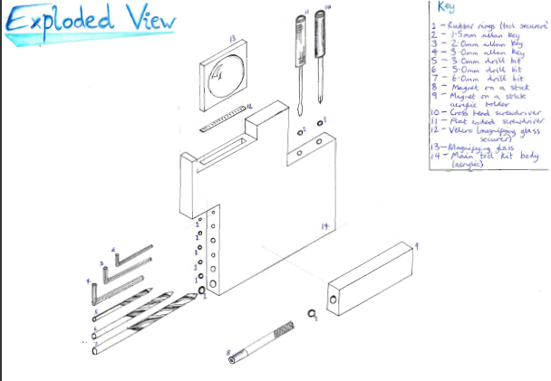
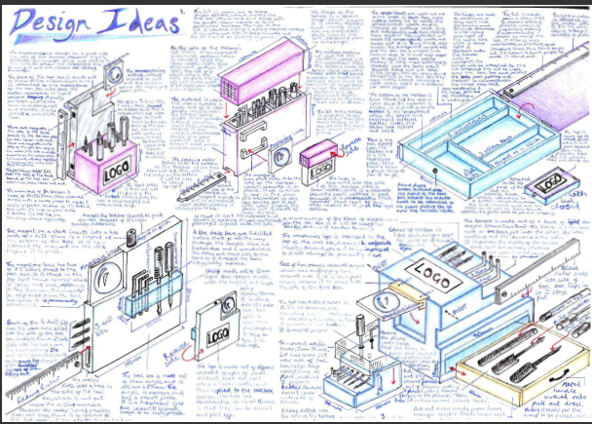
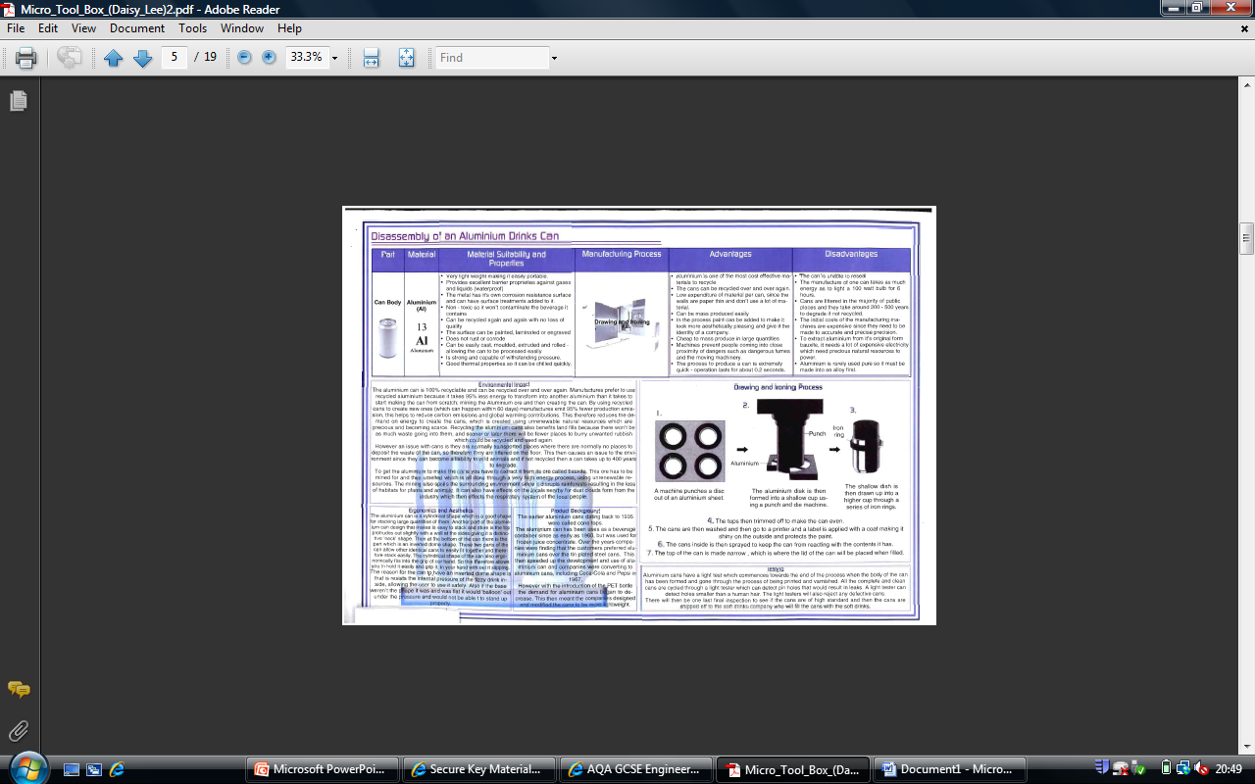
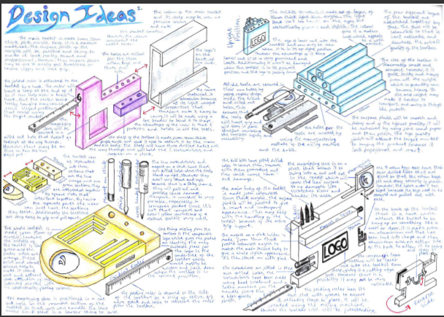
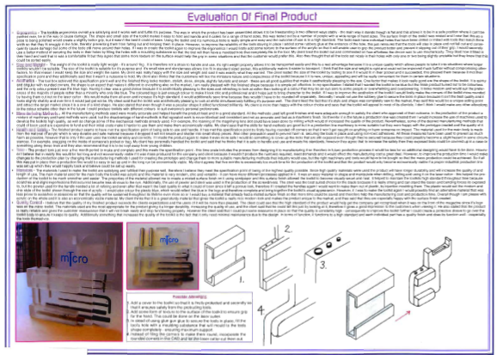
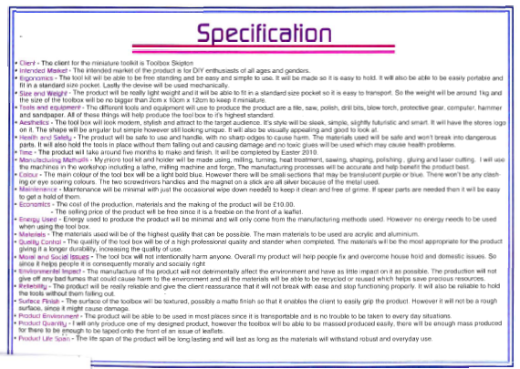
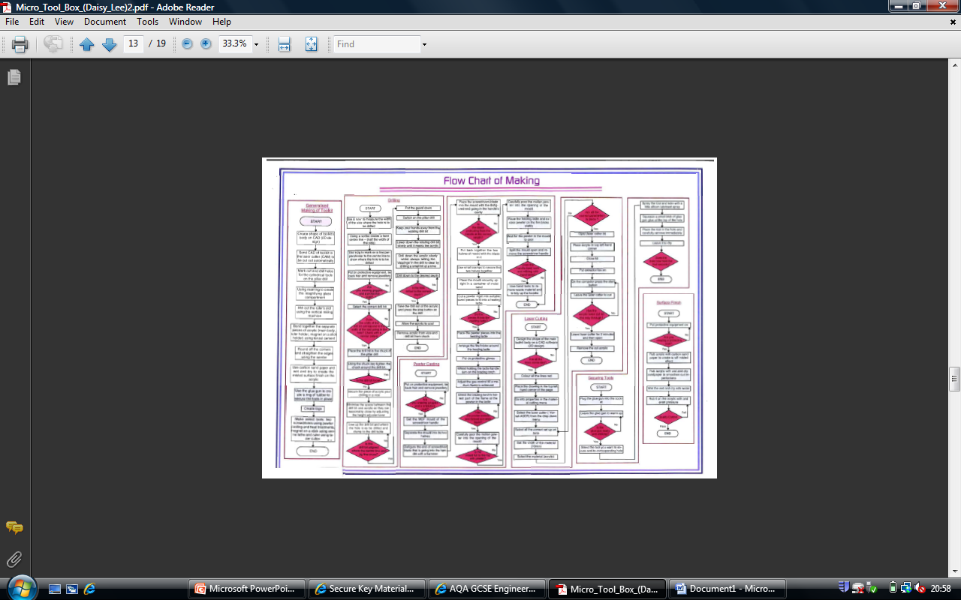
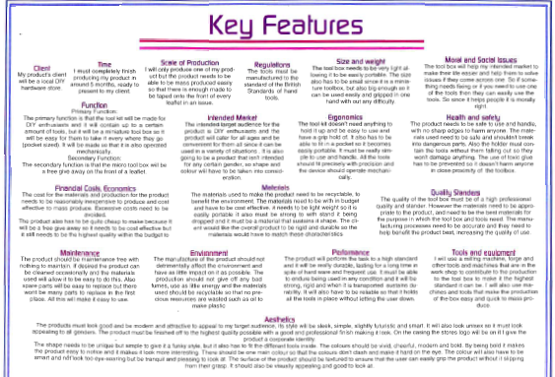
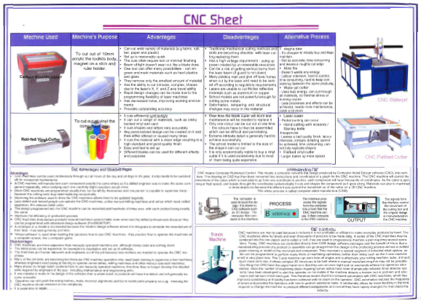
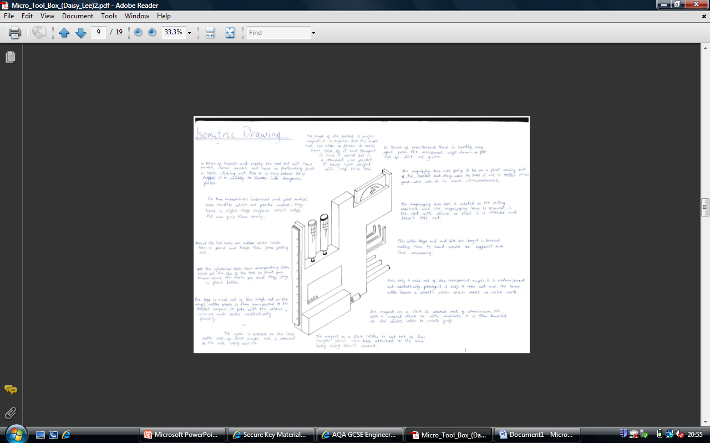
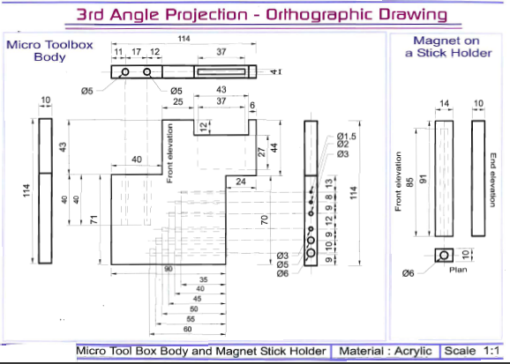
Exemplar Portfolio Pages
These pages are examples of the type of work you will be expected to produce in your portfolio of evidence.

Slide 8
You Should Pick Engineering if...
You are interested in how things work
You want to be part of the future and make a difference
You want to be able to design and make a working product
You are able to produce practical work to a very high standard.

Slide 9
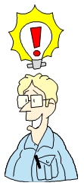
If you are interested in Engineering and want more information then speak to either Mrs Barker or Mr Barker in the Technology Department.

